Slide 1
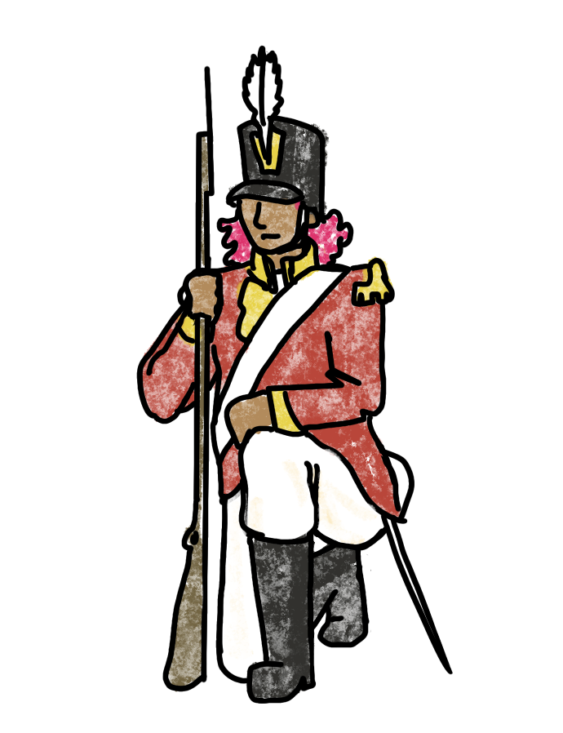
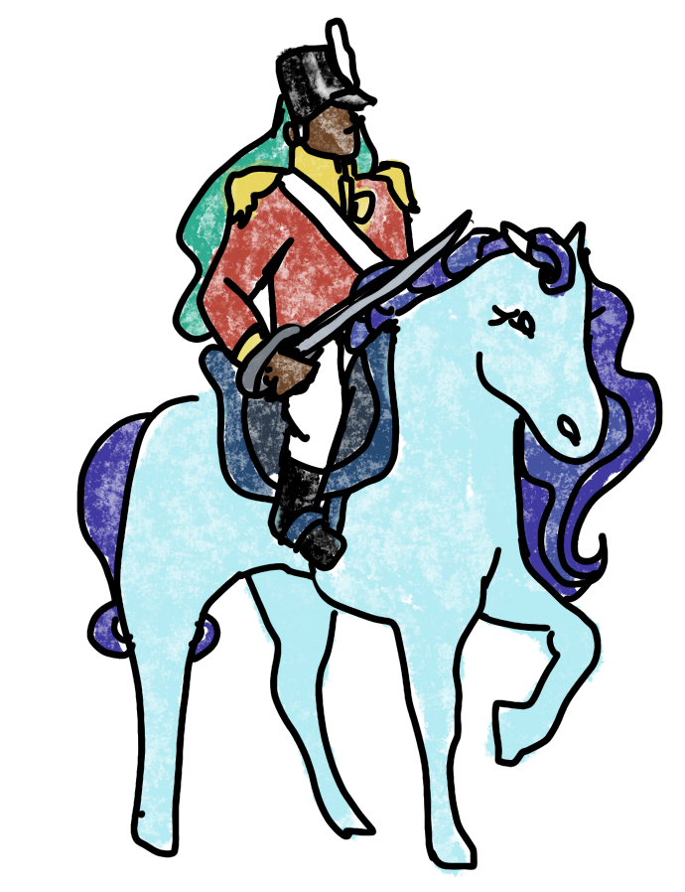
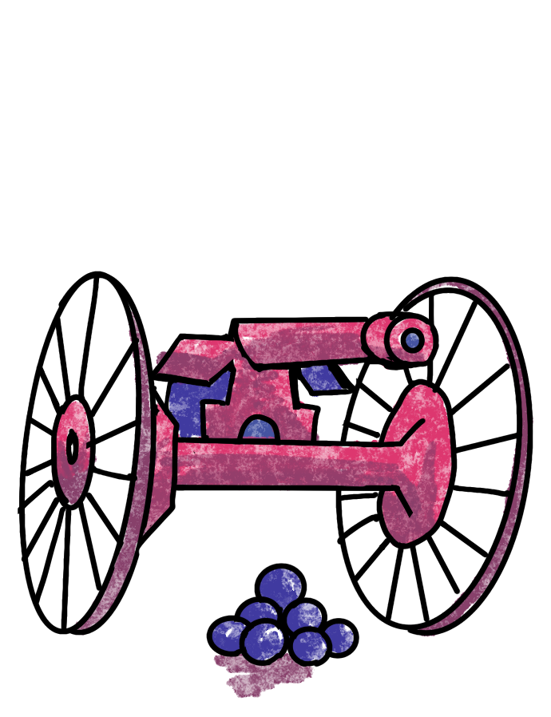
RISK
RL for Global Domination

Slide 2
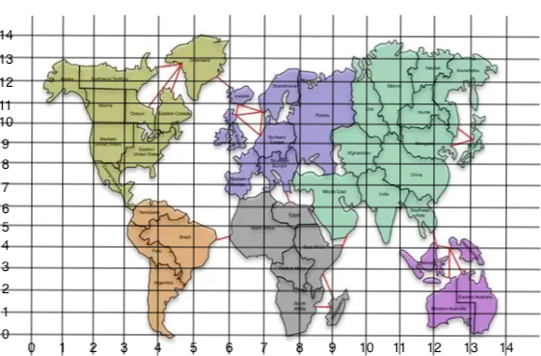
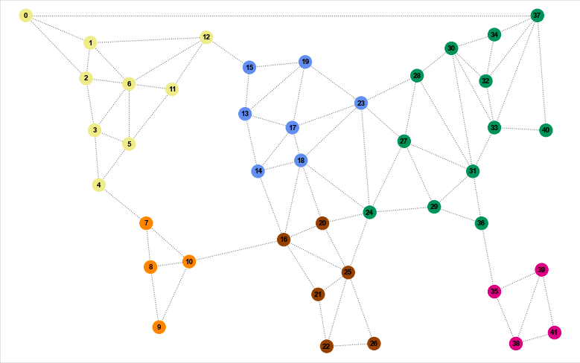
The board game map is not the best visualization for analysis
So, we turn it into a graph!

Slide 3
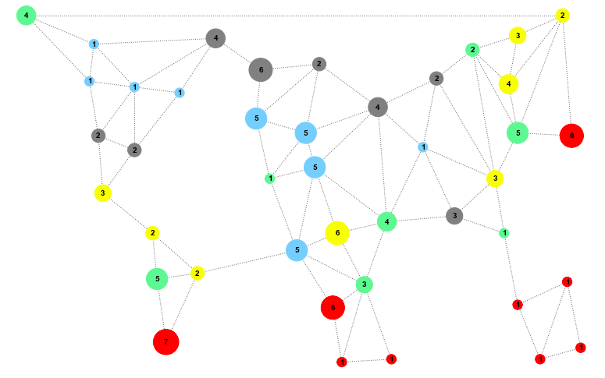
Simulation

Slide 4
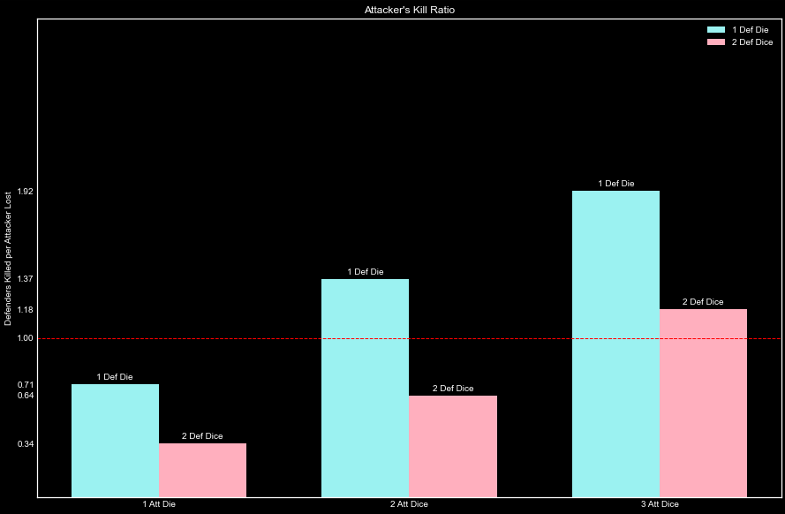
Battle Analysis
In small battles, the attacker is only at an advantage when outnumbering the defender

Slide 5
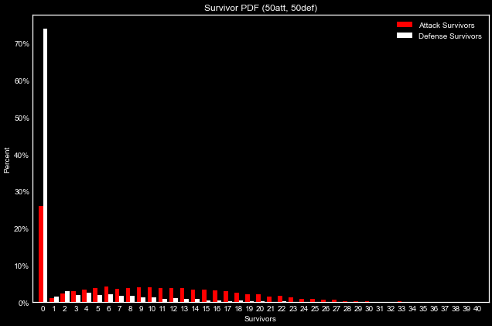
Battle Analysis
For very large battles, the kill ratio of 1.18 for 3 vs 2 dice gives the attacker a clear advantage.

Slide 6
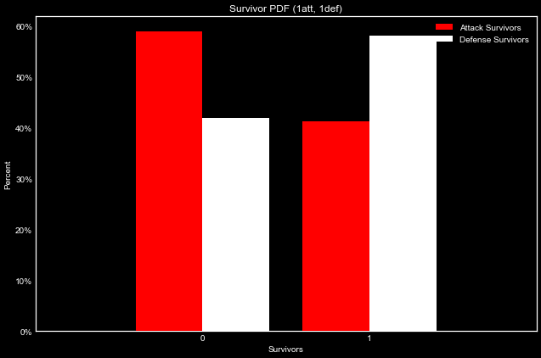
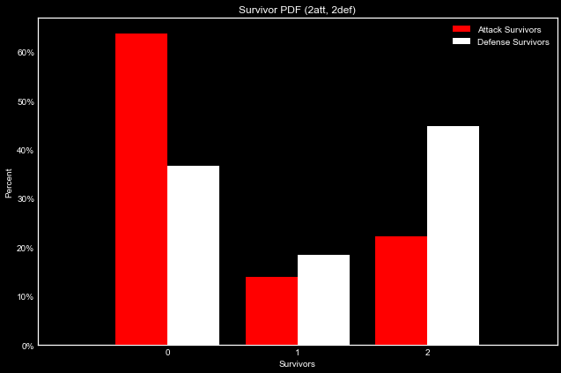
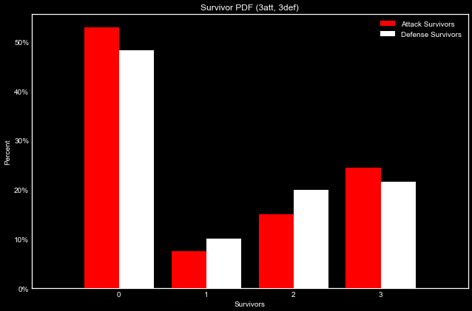
1 vs 1
2 vs 2
3 vs 3
Battle Analysis
Small battles mean the attacker doesn’t have an extra die advantage, or could quickly lose it.

Slide 7
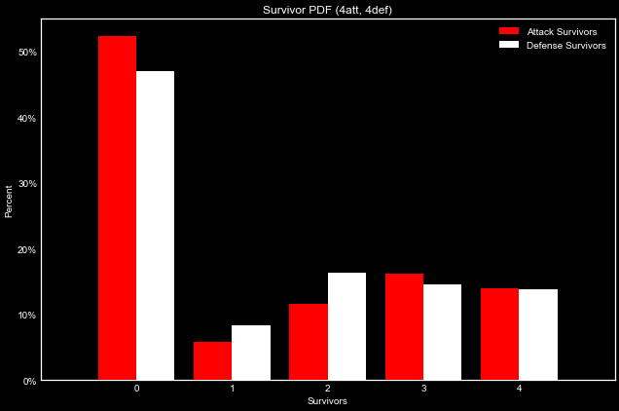
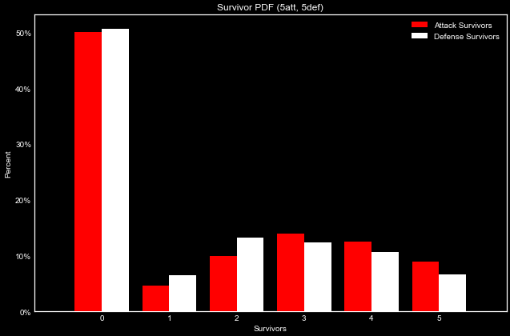
4 vs 4
5 vs 5
Battle Analysis
At 5 vs 5, the advantage of increased attack dice outweighs the effect of losing dice.

Slide 8
5 Player Risk Simulations
Test behavior competes against 4 randomly selected behaviors
Run game simulation 100 times for each test behavior
track win/loss
turns to win
turns until eliminated
Compare strategies
The data is IID!
Data Methods

Slide 9
Territory Selection Behaviors
'r' random, randomly selects territories from those remaining
'i' isolationist, selects the territories with the least neighbors, tie goes to those that have high cluster coefficients so that attackers have other options
'n' network, selects the territories with the most neighbors, tie goes to those that have low cluster coefficients so that everything passes through their nodes
'c' connecter, selects territories that are connected to ones it already owns; if none available maximizes neighbors and cluster coefficients
'u' united states, selects territories in N America first, then territories with the least neighbors. They're going for the continent bonus.
's' south america, selects territories in S America first, then territories with the least neighbors. They're going for the continent bonus.
'p' pacific islands, selects territories in Australia first, then territories with the least neighbors. They're going for the continent bonus.
'f' africa, selects territories in Africa first, then territories with the least neighbors. They're going for the continent bonus.
'e' europe, selects territories in Europe first, then territories with the least neighbors. They're going for the continent bonus.
'm' middle east, selects territories in Asia first, then territories with the least neighbors. They're going for the continent bonus.

Slide 10
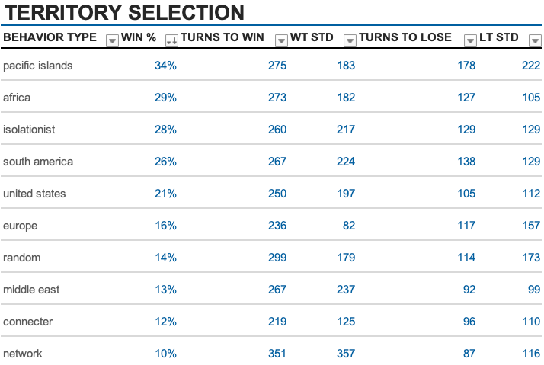

Slide 11
Troup Placement Behaviors
'r' random, places troops completely randomly for the initial phase; reinforcements are placed randomly on their front (if reinforcements are placed completely randomly, there is a good chance that a game between multiple players with this strategy won't finish so I had to revise the code).
'a' aggressive, places troops on their front in a way that maximizes vulnerability of enemy nodes; Tie goes to their territory with the least troops
'd' defensive, places troops on their front in a way that maximizes protection of their own nodes

Slide 12
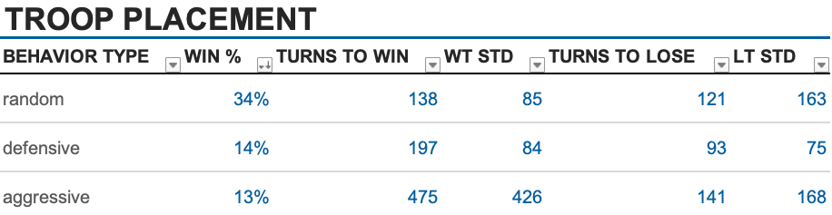

Slide 13
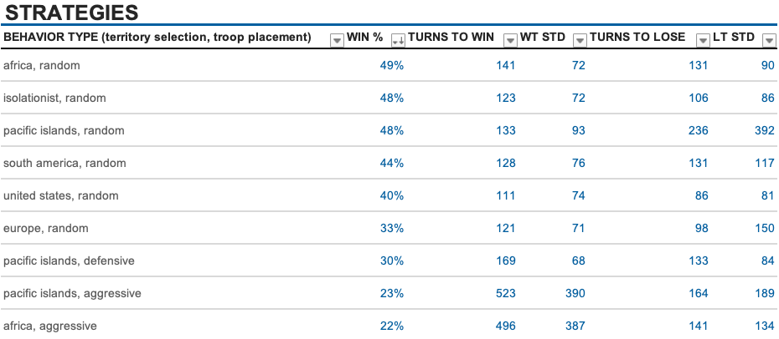
BEST OVERALL

Slide 14
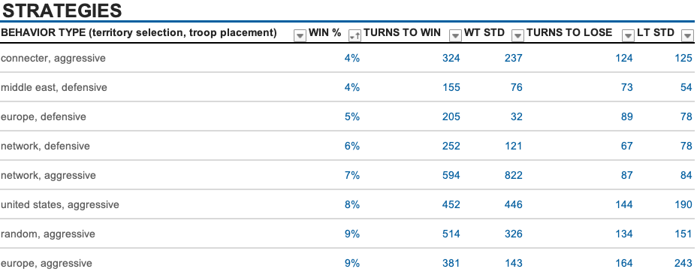
WORST OVERALL

Slide 15
Future Steps
Set up a pure reinforcement framework for the game.
Evolutionary algorithms to determine the best strategy for general play. Add variations of attack strategies.
Optimize speed (stuff like replacing battle simulation with a dictionary of probabilities of survivor distributions).
Get this model online so people can see animations of their favorites strategies.

Slide 16
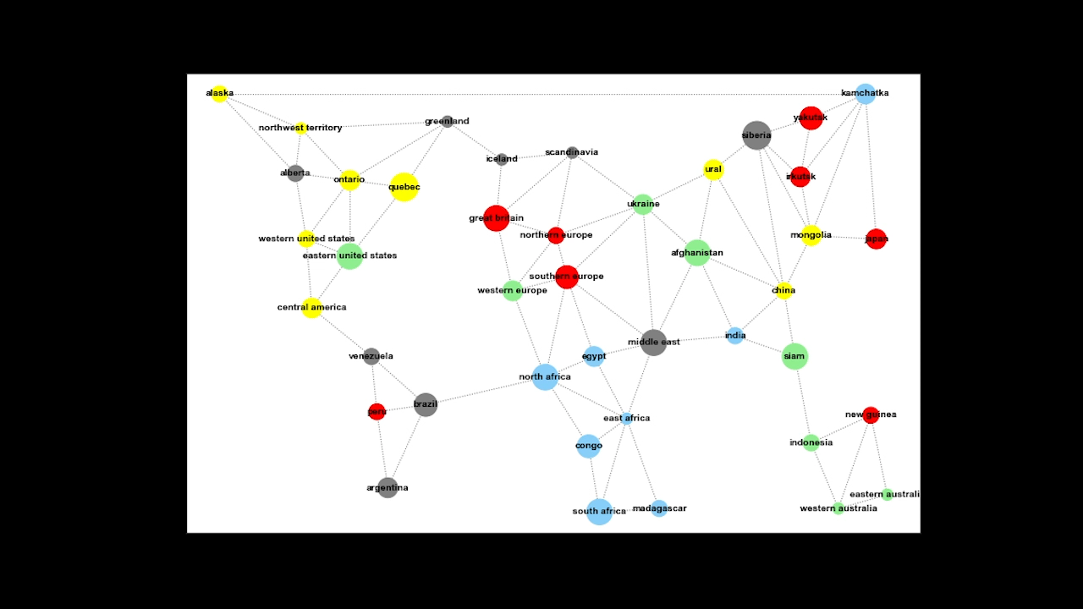

Slide 17
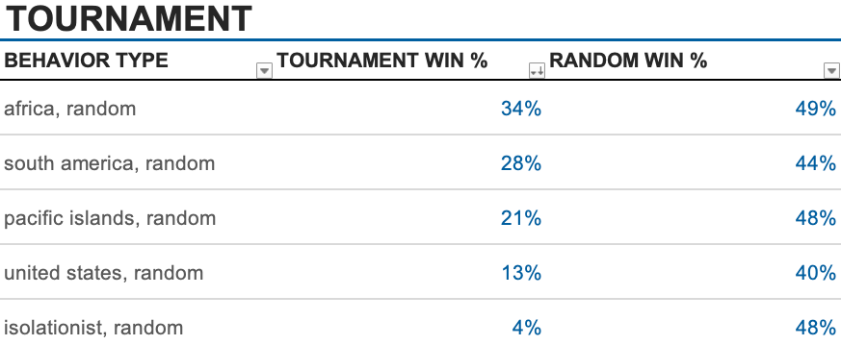
APPENDIX

Slide 18
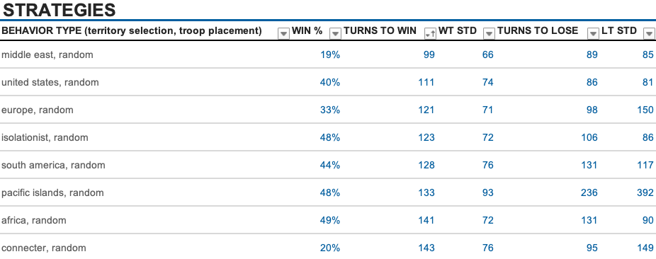
APPENDIX
FASTEST TO WIN

Slide 19
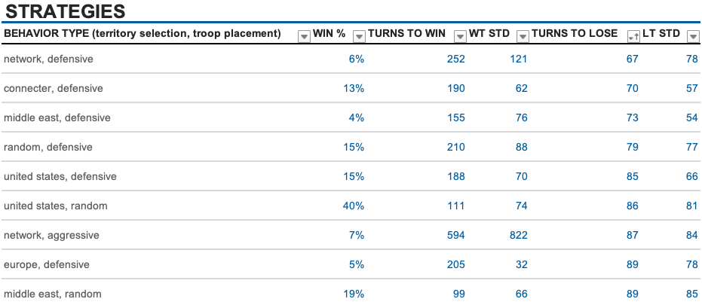
APPENDIX
FASTEST TO LOSE

